Slide 1
Interactive graphics

Slide 2
Introduction
Javascript graphics allows one to put data oriented graphics into web documents, apps and other reproducible + research documents.
Several well developed APIs have been developed to use Python, R ... as the base language where graphics are output as javascript
Here, we'll go through some examples using plotly

Slide 3
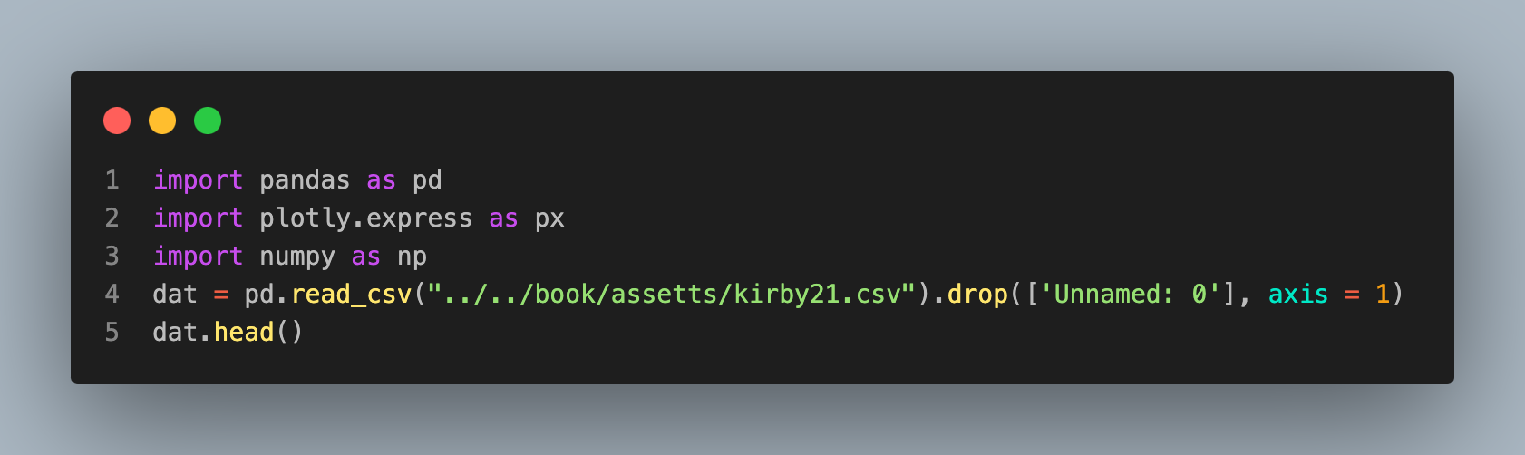
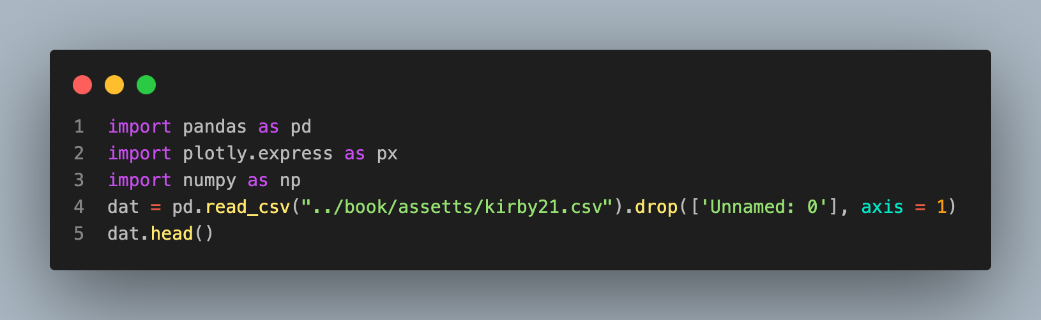
Using plotly
Consider the dataset that has regional volumes for 20 subjects in a long dataset
 | id | roi | volume
0 | 127 | Telencephalon_L | 531111
1 | 127 | Telencephalon_R | 543404
2 | 127 | Diencephalon_L | 9683
3 | 127 | Diencephalon_R | 9678
4 | 127 | Mesencephalon | 10268

Slide 4
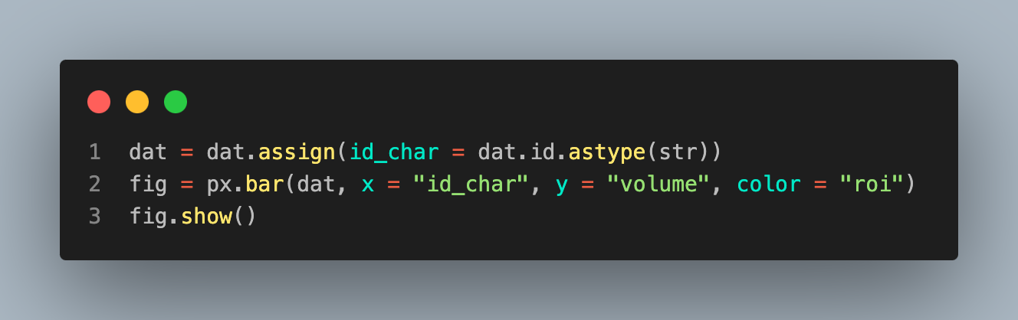
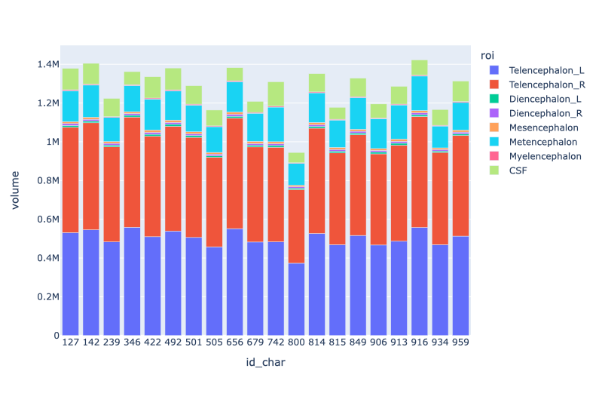
Individual subjects
Let's view individual subjects. The id variable is a numeric variable, so let's create a string version.

Slide 5
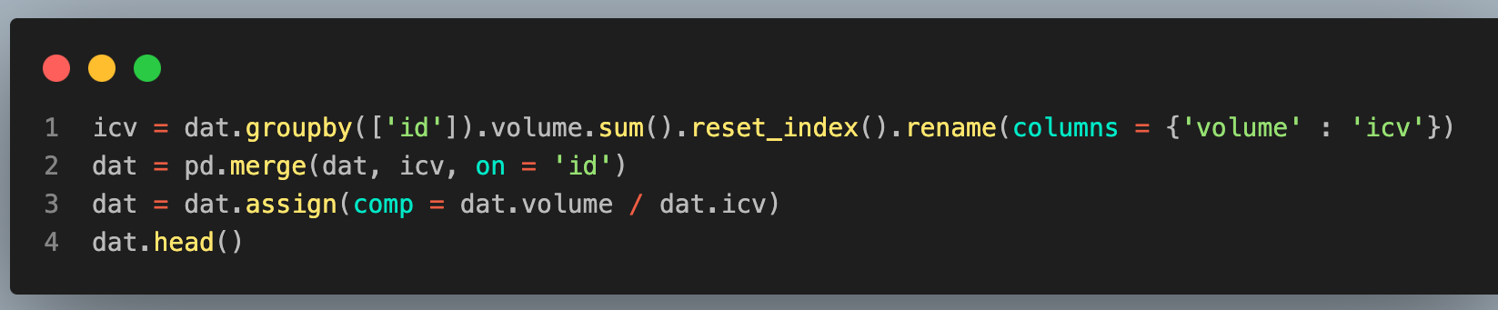
Let's add an intra-cranial volume column by grouping by id, summing all volumes, then merging that data back into the main data. We'll then add a composition variable, which is the regional volumes divided by the intra-cranial volume.
 | id | roi | volume | id_char | icv | comp
0 | 127 | Telencephalon_L | 531111 | 127 | 1378295 | 0.385339
1 | 127 | Telencephalon_R | 543404 | 127 | 1378295 | 0.394258
2 | 127 | Diencephalon_L | 9683 | 127 | 1378295 | 0.007025
3 | 127 | Diencephalon_R | 9678 | 127 | 1378295 | 0.007022
4 | 127 | Mesencephalon | 10268 | 127 | 1378295 | 0.007450

Slide 6
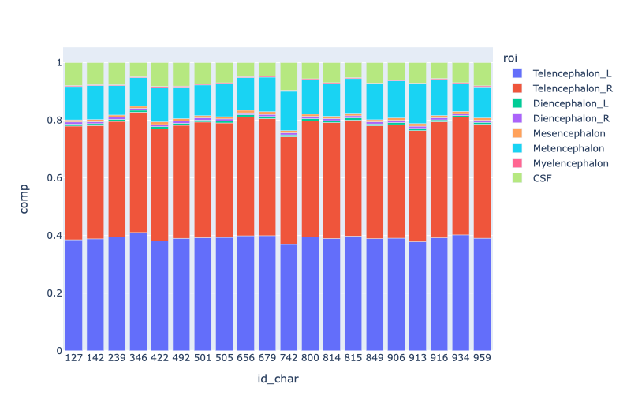
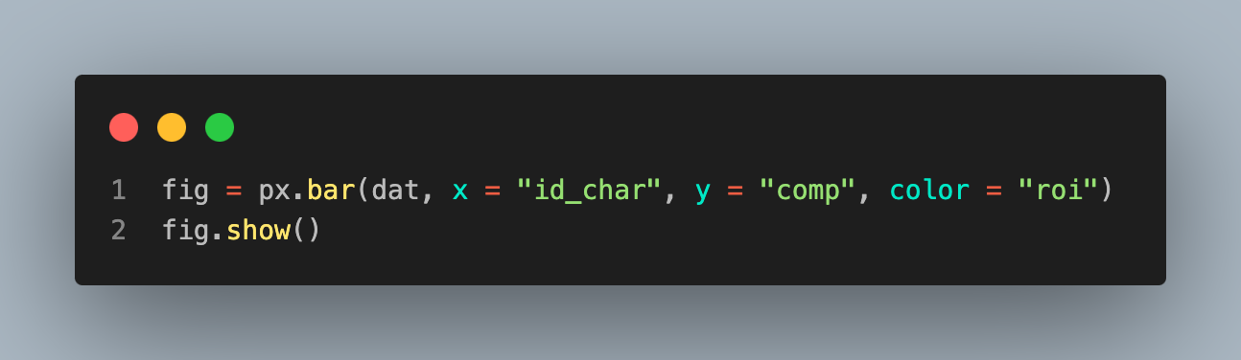
Normalized plot
Let's now replot our compositional data (but now normalized to have height 1).

Slide 7
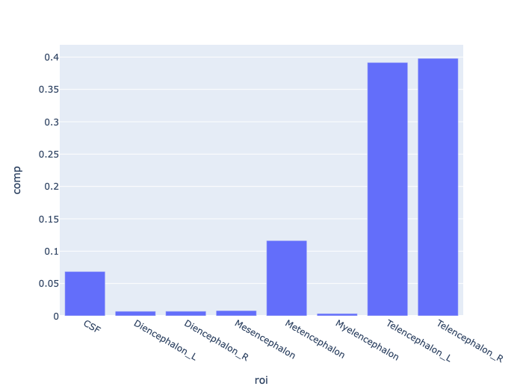
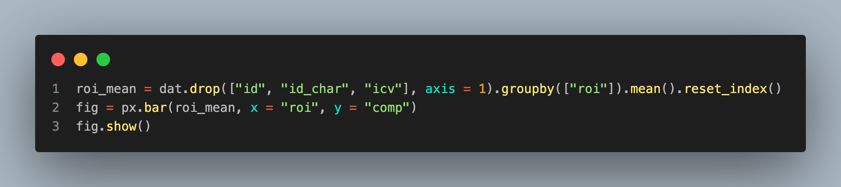
Let's look at the subject level means. Therefore, we have to average across id.

Slide 8
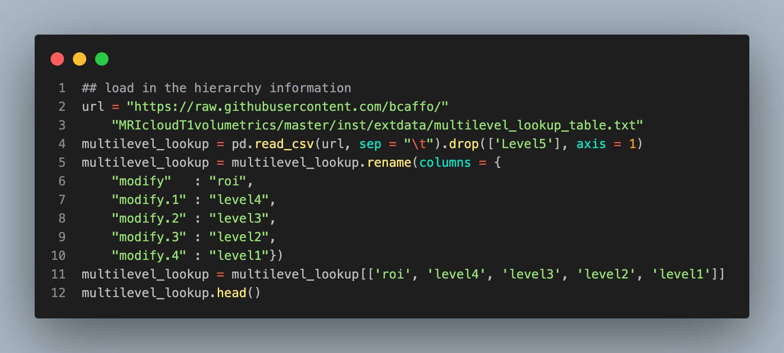
Hierarchies
There's a hierarchy of regions in this dataset. Let's visualize a subject's type 1 level 5 data as it exists in the hierarchy.
 | roi | level4 | level3 | level2 | level1
0 | SFG_L | SFG_L | Frontal_L | CerebralCortex_L | Telencephalon_L
1 | SFG_R | SFG_R | Frontal_R | CerebralCortex_R | Telencephalon_R
2 | SFG_PFC_L | SFG_L | Frontal_L | CerebralCortex_L | Telencephalon_L
3 | SFG_PFC_R | SFG_R | Frontal_R | CerebralCortex_R | Telencephalon_R
4 | SFG_pole_L | SFG_L | Frontal_L | CerebralCortex_L | Telencephalon_L

Slide 9
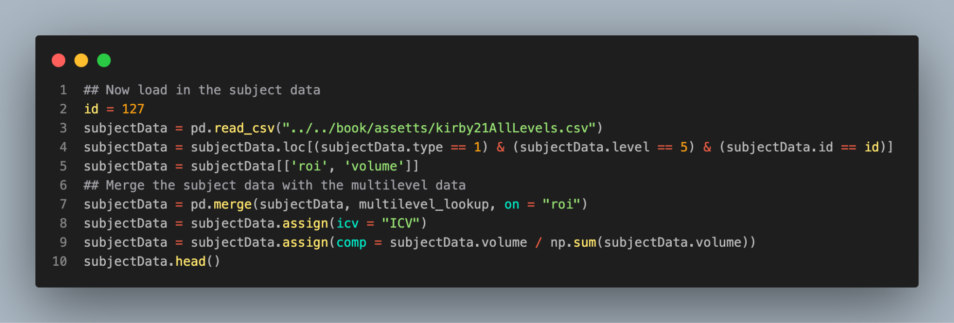
 | roi | volume | level4 | level3 | level2 | level1 | icv | comp
0 | SFG_L | 12926 | SFG_L | Frontal_L | CerebralCortex_L | Telencephalon_L | ICV | 0.009350
1 | SFG_R | 10050 | SFG_R | Frontal_R | CerebralCortex_R | Telencephalon_R | ICV | 0.007270
2 | SFG_PFC_L | 12783 | SFG_L | Frontal_L | CerebralCortex_L | Telencephalon_L | ICV | 0.009247
3 | SFG_PFC_R | 11507 | SFG_R | Frontal_R | CerebralCortex_R | Telencephalon_R | ICV | 0.008324
4 | SFG_pole_L | 3078 | SFG_L | Frontal_L | CerebralCortex_L | Telencephalon_L | ICV | 0.002227

Slide 10
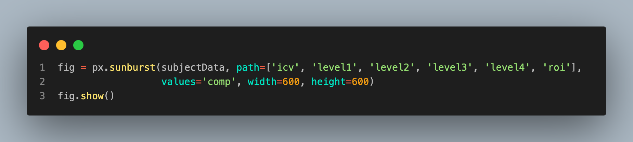
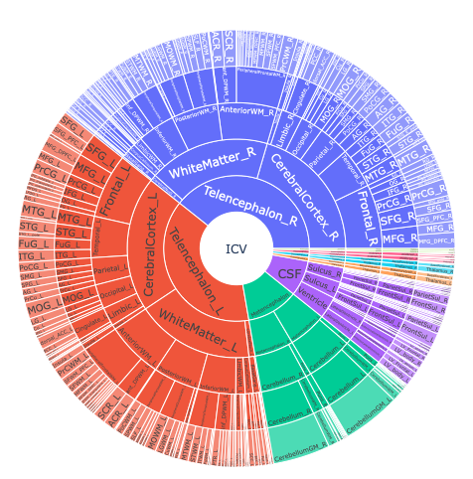

Slide 11
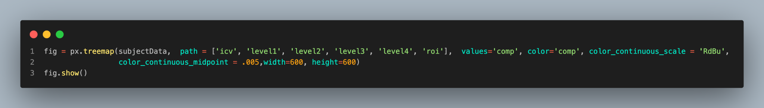
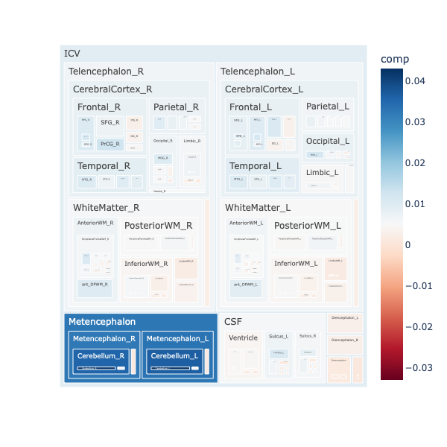

Slide 12
Interactive maps using folium and leaflet
A common form of interactive graphic is a map.
There are several mapping libraries for python, including some in plotly.
folium is another option that connects to the well known leaflet javascript library.
Let's create a quick plot of the Bloomberg School of Public Health Building, which is at latitude and longitude 39.298, -76.590.

Slide 13
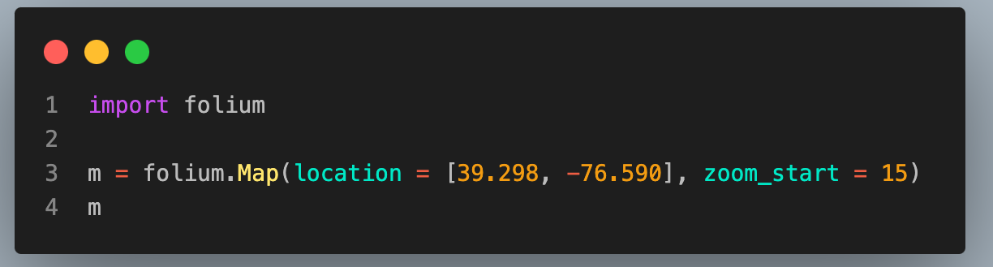
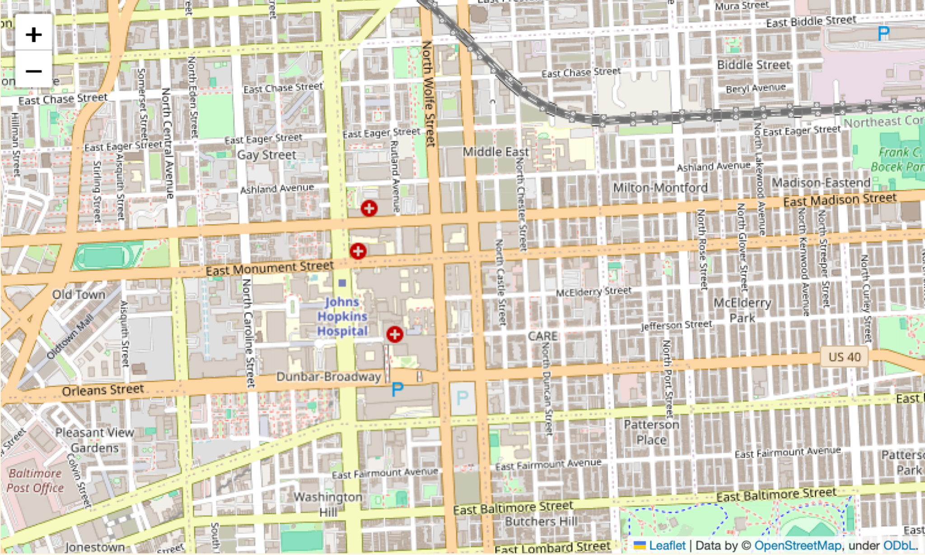

Slide 14
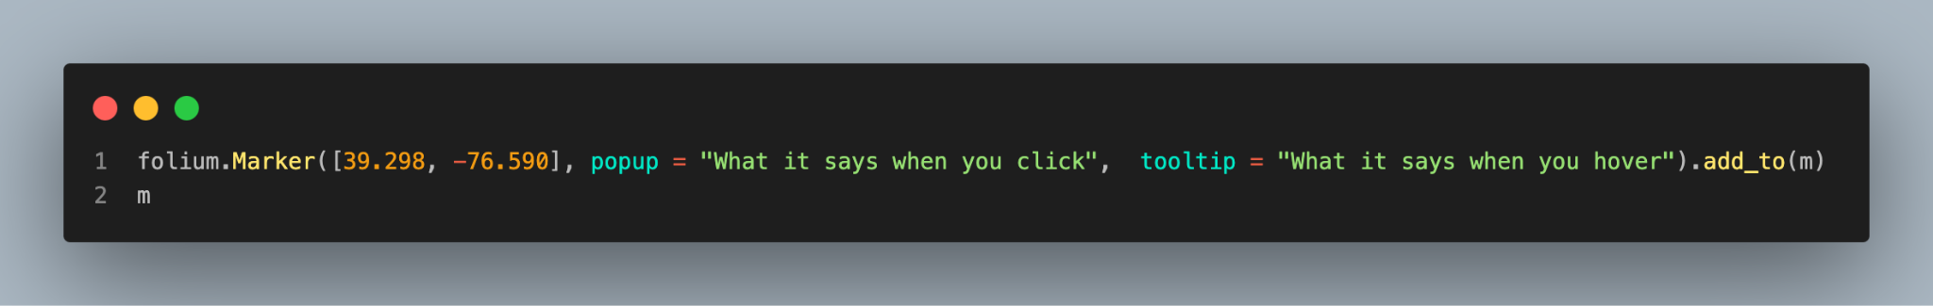
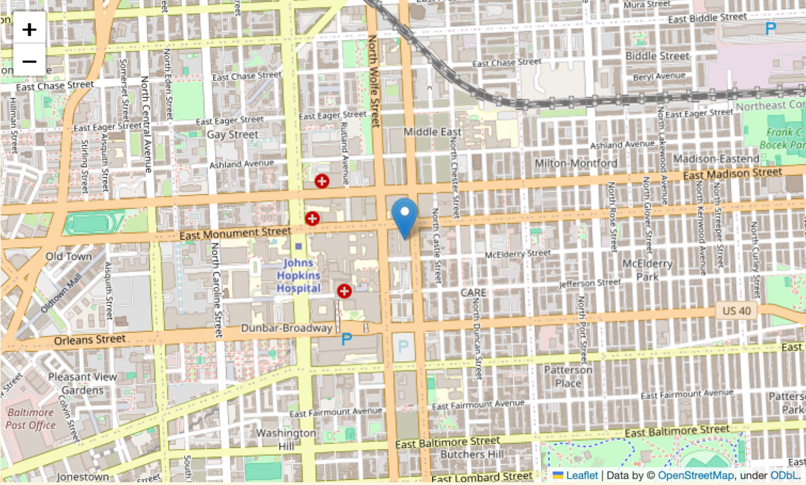
You can then add elements to the map. For example, suppose we want a marker on the building saying, "my office". It's just that easy! This is truly just the tip of the iceberg of using folium/leaflet.

